Slide 1

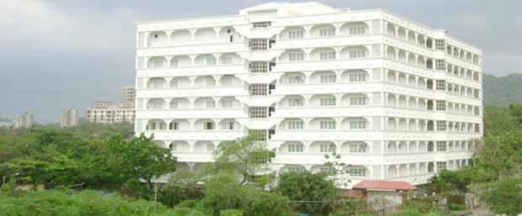

Mahavir Education Trust’s
Shah & Anchor Kutchhi Engineering College
Chembur, Mumbai-400088
(Autonomous College Affiliated to the University of Mumbai)
Bestowed with the University of Mumbai’s Best College Honor 2024-25 www.sakec.ac.in

Slide 2
Atmos Weather Application
A Robust Java Desktop Solution for Real-Time Meteorological Analytics & Visualization
Project Members
Khan Mohammed Suraqa Tabrez
SYECS1-21
Khan Owais Muqtada
SYECS1-22

Slide 3
Table of Contents
Index
01
Introduction
06
Challenges Faced & Solutions
02
Scope of Project
07
Learning Outcomes
03
Project Overview
08
Conclusion
04
Results & Screenshots
09
References
05
Code Snippets

Slide 4
3. Scope of Project
Essential Scope
cloud_queue
Real-Time Data Retrieval
Integrating live Weather APIs (WeatherAPI.java) to fetch current temperature, humidity, wind patterns, and atmospheric conditions dynamically.
bar_chart
Advanced Analytics
Analyzing historical data patterns and forecasts using custom algorithms (WeatherAnalyzer.java) and interactive graphical UI (GraphPanel.java).
folder_open
Persistence & Logs
Managing file logs and previous session history reliably through FileManager.java and HistoryManager.java for efficient offline lookup.

Slide 5
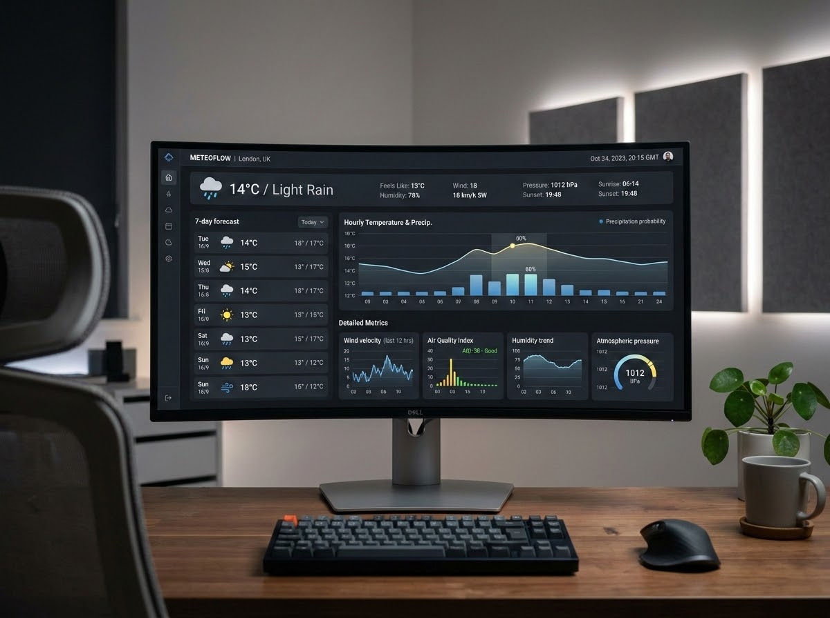
Project Overview
Architecture & Components
Atmos is structured using a modular Java Swing architecture separating UI components (Dashboard.java, ComparePanel.java) from back-end logic (Utils.java, WeatherData.java).
Modular Design
Clean separation between data parsing and rendering views.
User Experience
Responsive layout supporting multi-location comparison and dashboard insights.

Slide 6
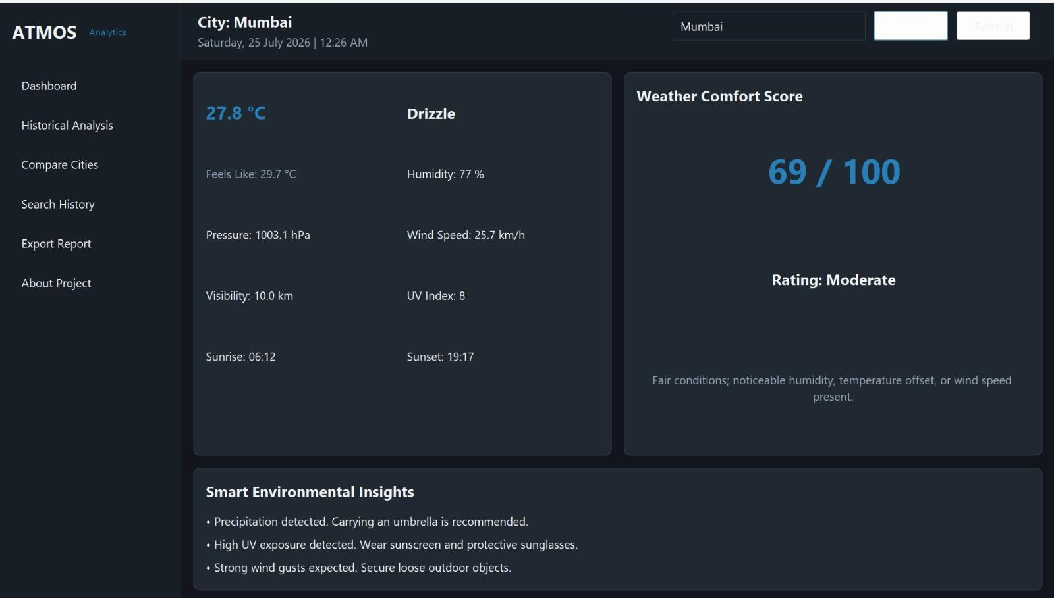
Project Output
Results & Screenshots

Slide 7
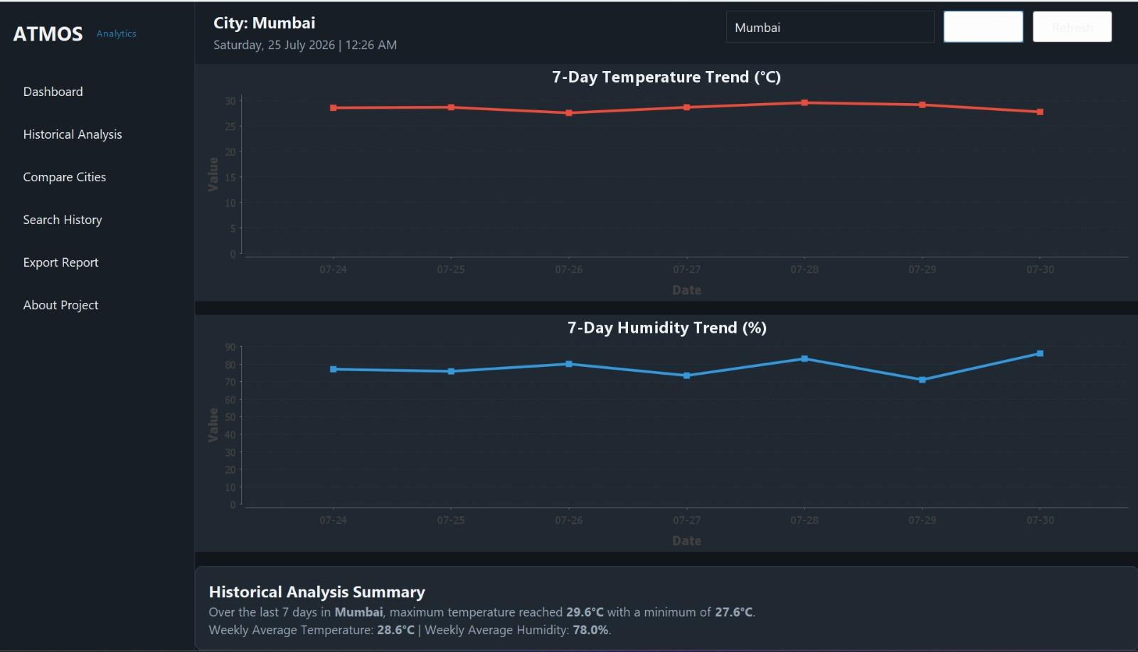
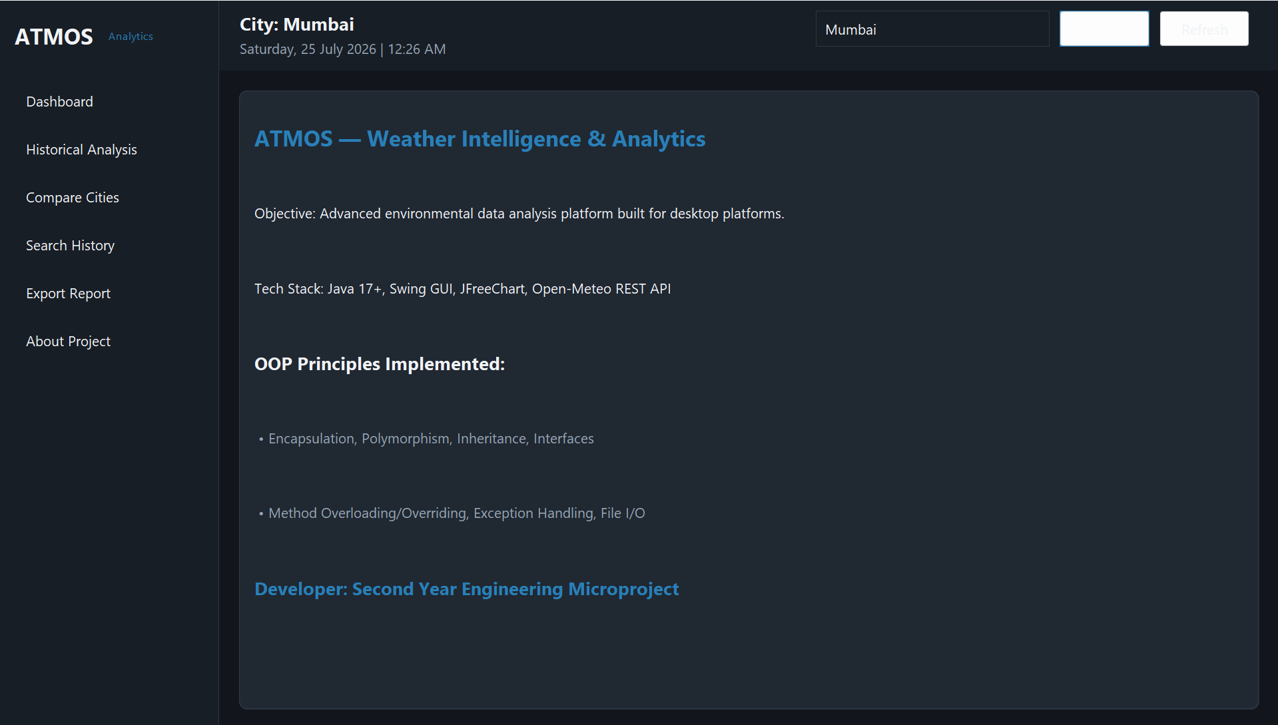

Slide 8
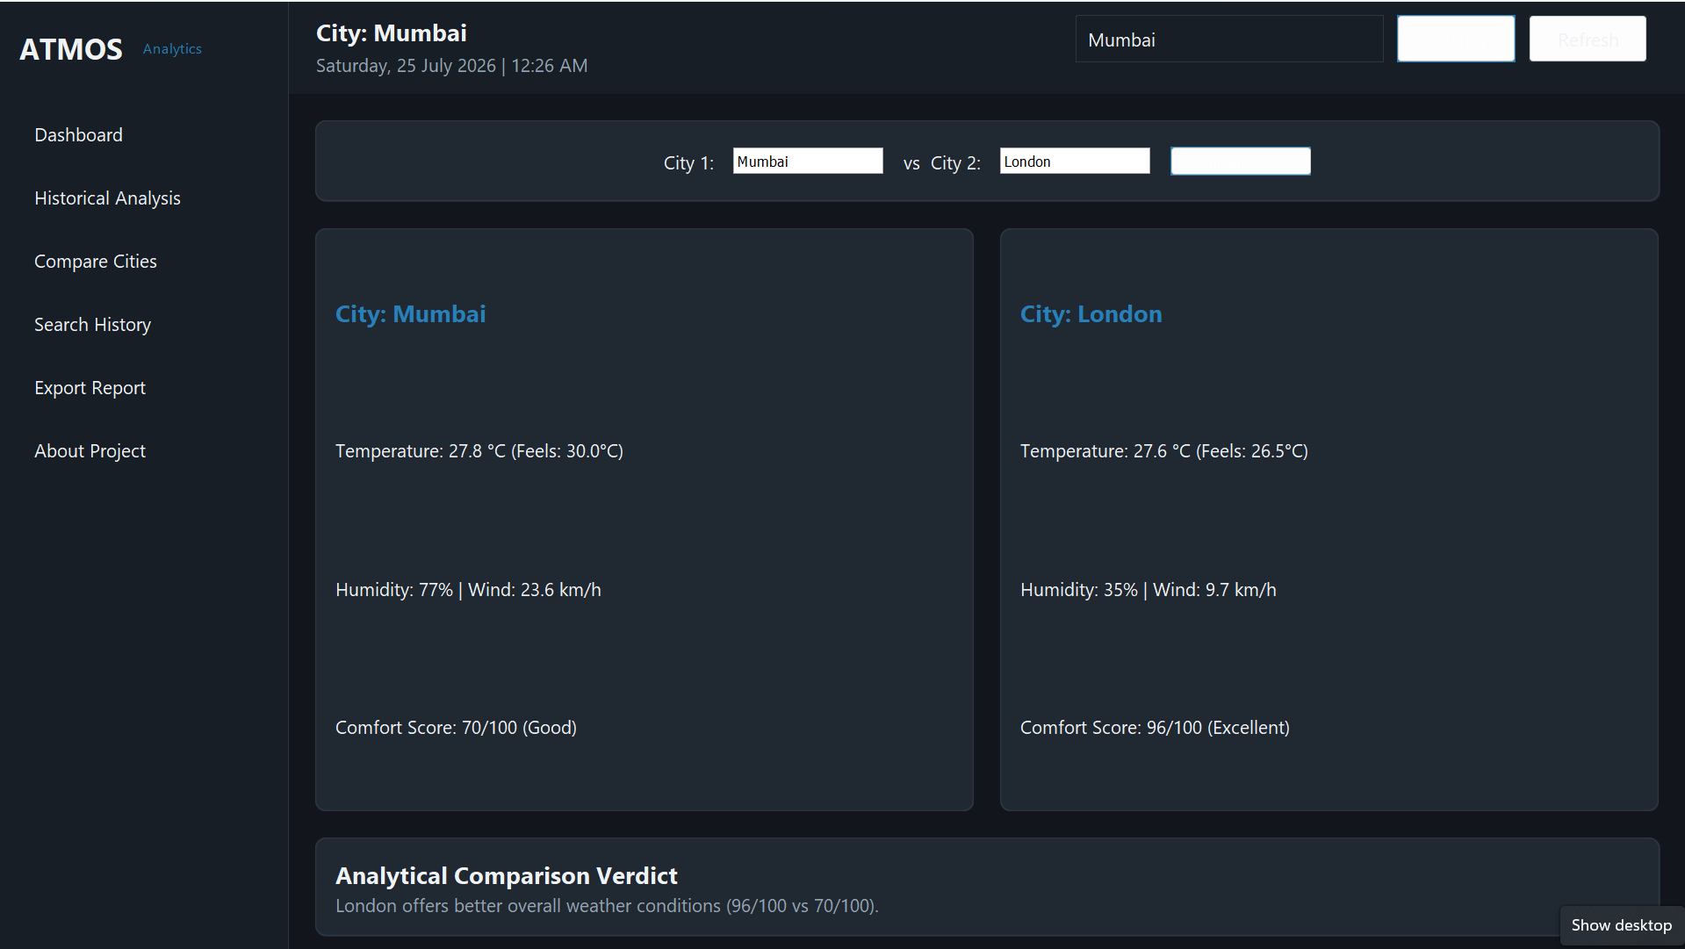
Project Output
City Comparison

Slide 9
Project Implementation
Code Snippets
1. Encapsulation — Private Attributes & Accessors
public class WeatherData {
private String cityName;
private double temperature;
// Encapsulated Getters & Setters
public String getCityName() {
return cityName;
}
public void setCityName(String name) {
this.cityName = name;
}
public double getTemperature() {
return temperature;
}
public void setTemperature(double temp) {
this.temperature = temp;
}
}
2. REST API Connection & Exception Handling
URL url = new URI(geoUrlStr).toURL();
HttpURLConnection conn =
(HttpURLConnection) url.openConnection();
conn.setRequestMethod("GET");
conn.setConnectTimeout(6000);
if (conn.getResponseCode() == 200) {
BufferedReader reader = new BufferedReader(
new InputStreamReader(conn.getInputStream())
);
// Parses incoming REST JSON stream
// into WeatherData DTO
}

Slide 10
Project Implementation
Code Snippets
3. Polymorphism — Dynamic Comfort Score
public class WeatherAnalyzer {
// Overloaded Signature 1
public static ComfortReport calculateComfortScore(WeatherData data) { ... }
// Overloaded Signature 2
public static ComfortReport calculateComfortScore(double temp, int humidity) {
double score = 100.0 - (Math.abs(temp - 22) * 2) - ((humidity - 50) * 0.5);
return new ComfortReport((int) Math.max(0, score), "Good");
}
}
4. Collections Framework — Memory Mgmt
public class HistoryManager {
private final List<WeatherData> history = new ArrayList<>();
public void addRecord(WeatherData data) {
history.add(data);
}
public List<WeatherData> getHistory() {
return history;
}
}

Slide 11
Challenges & Learning Outcomes
Challenges Faced
error_outlineIntegrating REST APIs
error_outlineHandling JSON data parsing
error_outlineManaging network exceptions
error_outlineDesigning a responsive Java Swing GUI
error_outlineOrganizing using Object-Oriented Programming
Learning Outcomes
check_circleApplied Object-Oriented Programming concepts
check_circleWorked with REST APIs & HTTP communication
check_circleImplemented Java Swing GUI development
check_circleImproved exception handling & debugging skills
check_circleEnhanced modular programming & project structuring

Slide 12
Project Conclusion
Conclusion
check_circleSuccessfully developed a Java-based desktop weather application.
check_circleIntegrated real-time weather data using REST APIs.
check_circleApplied Object-Oriented Programming concepts including Encapsulation, Polymorphism, and Collections.
check_circleDeveloped an interactive Java Swing graphical user interface.
check_circleStrengthened practical software development, debugging, and API integration skills.
Thank You

